Slide 1
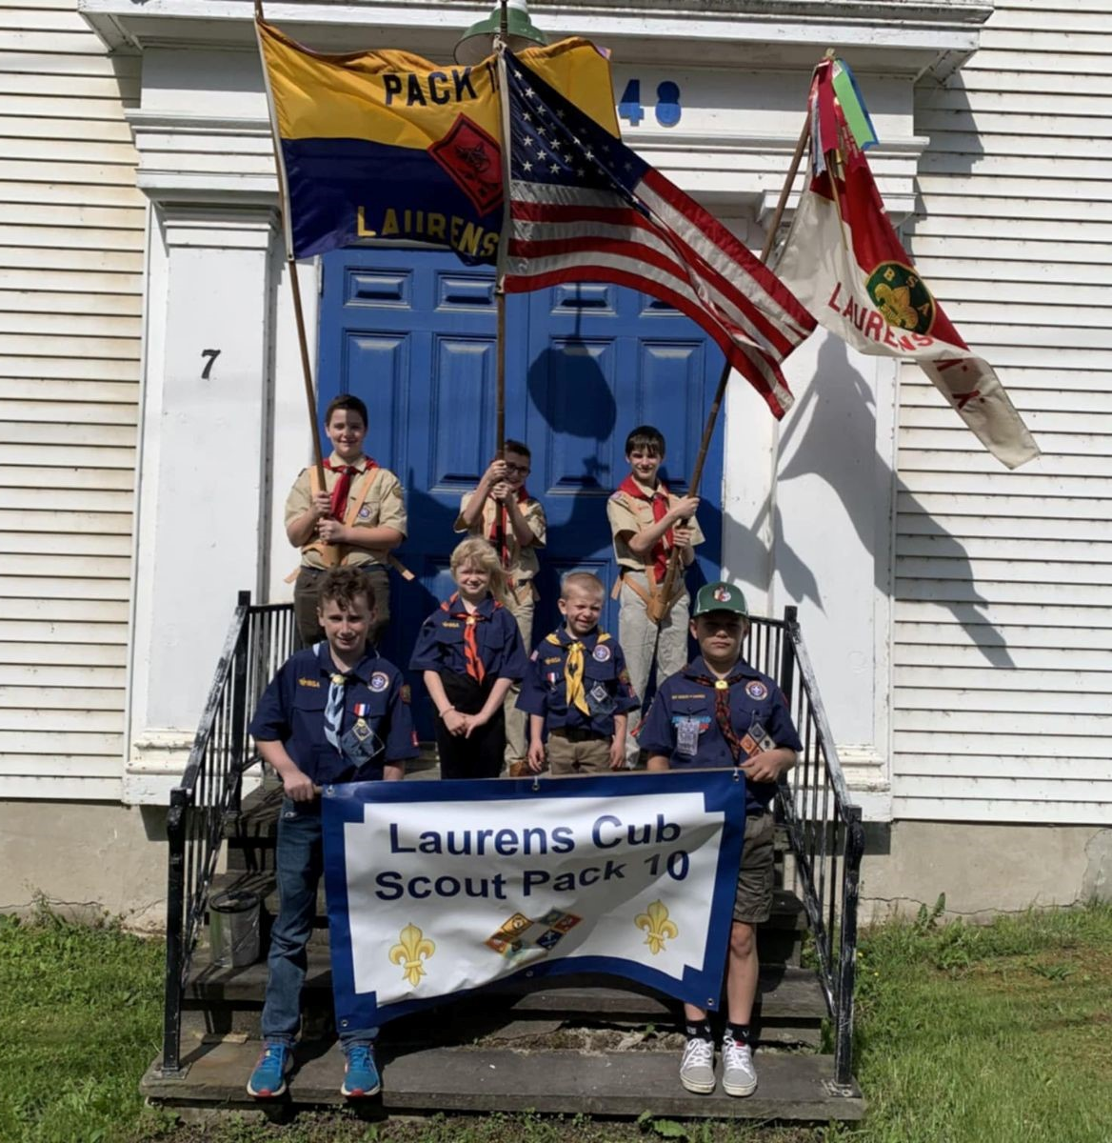
Scouting America: Leatherstocking Council’s Spring Sale 2025!!
Whitley’s Peanut Factory!

Slide 3
We have partnered with Whitley’s Peanut Factory once again to offer units a spring product sale of high quality!

Slide 4
Units and Scouts should participate in the sale to reduce or eliminate the cost of registration; summer camp or other planned scouting trips for the summer of 2025!
Units can earn 40% commission on their total unit sale.

Slide 5
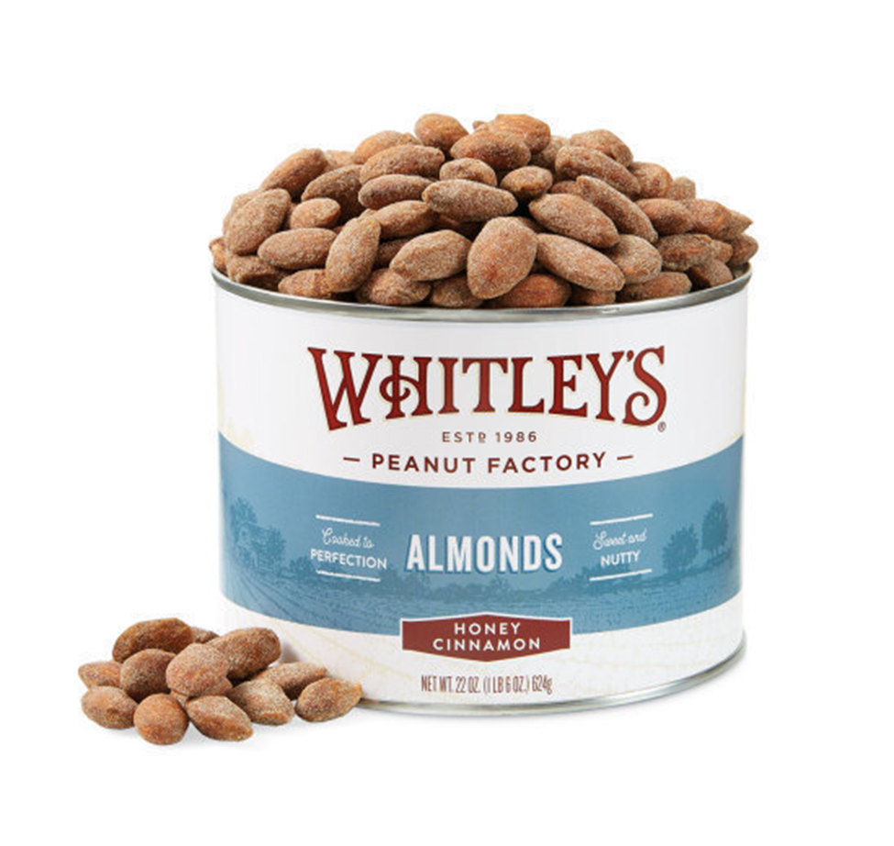
The spring sale product list consists of 12 individual items including:
Dark Chocolatey Peanut Clusters
Honey Cinnamon Almonds
Honey Roasted Virginia Peanuts
Dark Chocolatey Almond Clusters
Virginia Trail Mix (New this year!!) and More!
The complete list can be found on the order form. We will provide each youth with a printed color flyer to use for his/her take order sales.

Slide 6
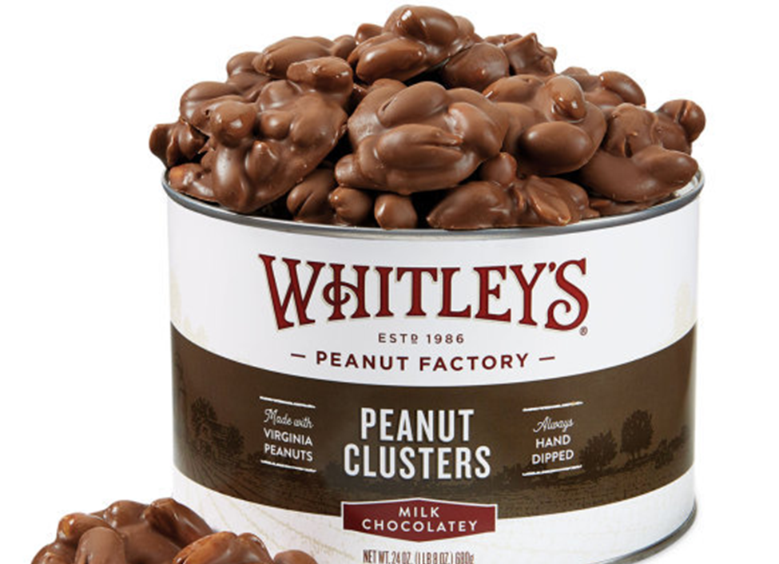
Whitley’s products are handmade, cooked peanuts by hand and hand dipped peanut clusters one at a time with care and attention.
They choose only the highest quality, extra-large Virginia peanuts, selected for their size and freshness.
Whitley’s has been family owned since 1986.

Slide 8
Video?

Slide 9
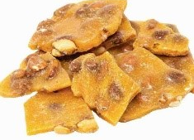
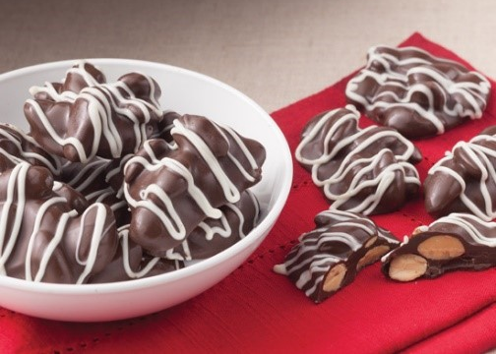
March 1st Sale begins!
April 7th Take order forms are due online
Week of April 21st take order delivery approximately
Payment due to the council office May 5

Slide 10
Flyers are available, please reach out!

Slide 11
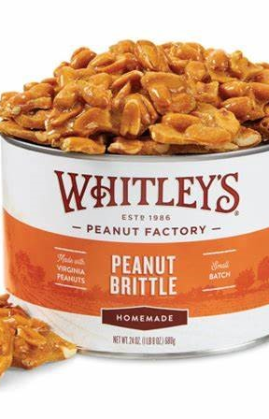
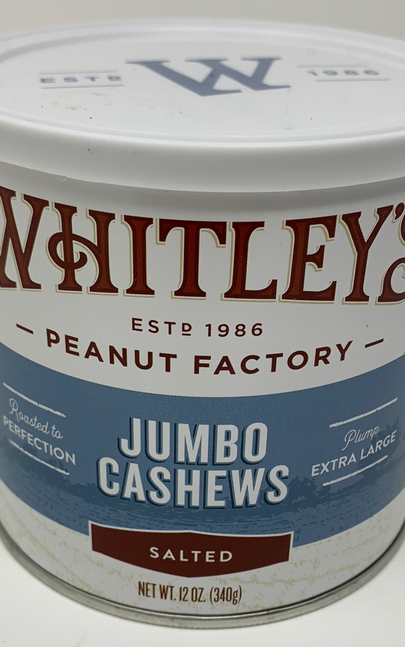
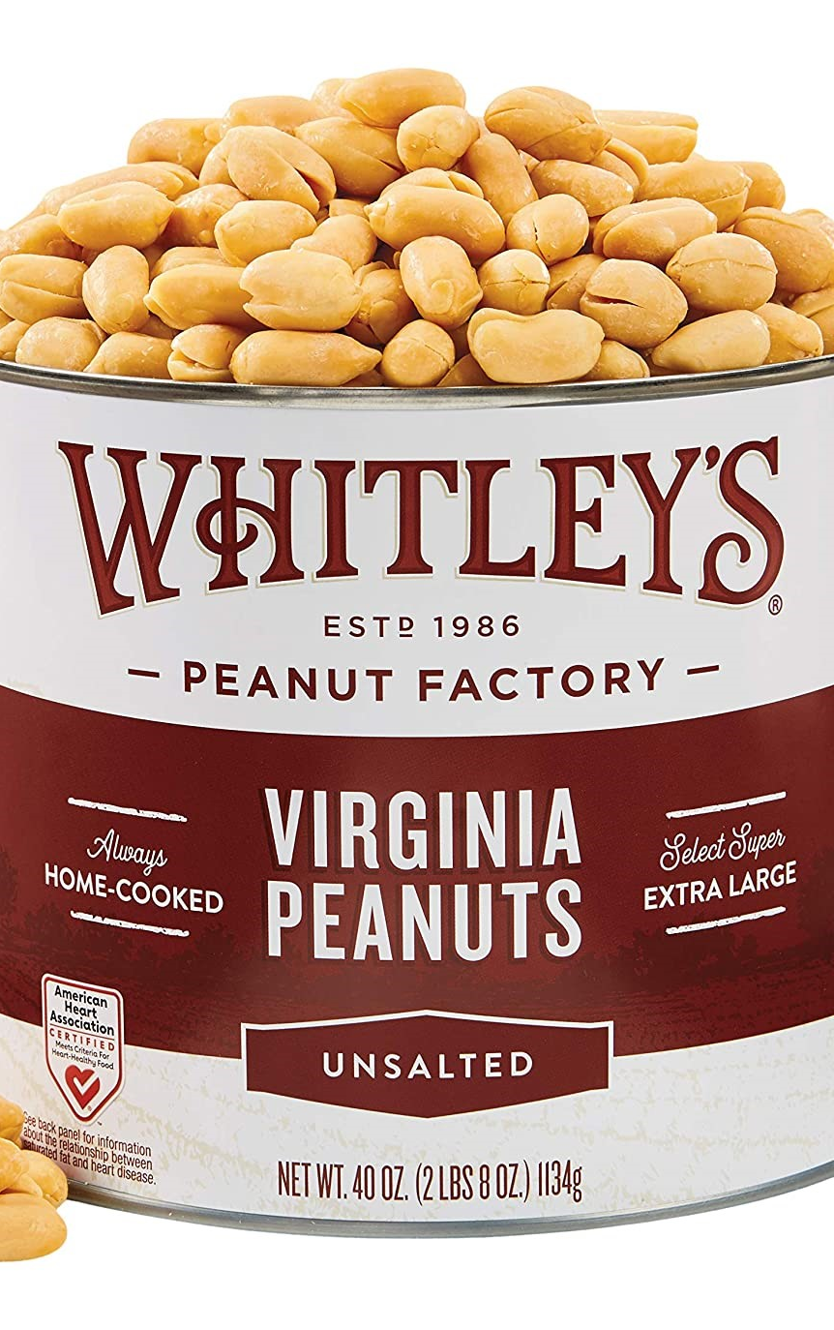
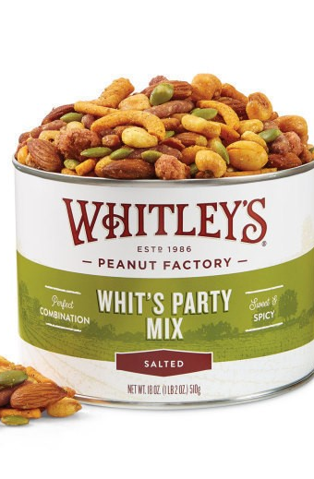
Thanks for supporting our Scouts again in 2025!

